Slide 1
Final Project Presentation
Christopher Evangelista

Slide 2
Understanding GameCo’s Customer
The target customer base has shifted over the past decade. In order to capture market share in a shrinking industry, must focus on key details
The global share of gamers has shifted from NA to EU
Develop games on current/new generation platforms
Invest in growing and stable genres

Slide 3
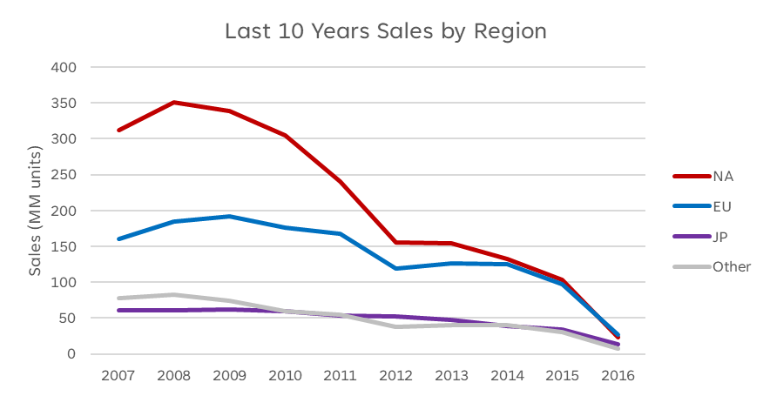
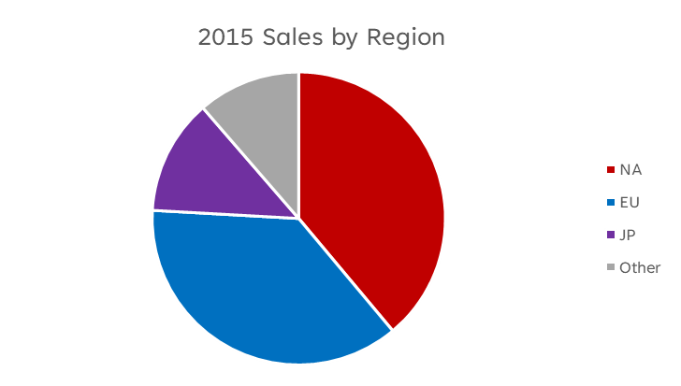
Regional Resource Allocation
Although the boxed video game market has seen a decline in sales over the last 10 years, the EU region has seen a less of decline than NA and thus have caught up
The JP and Other regions have seen relatively no change
GameCo should shift some of its resources from NA to EU

Slide 4
Platform market
The past 10 years has seen a shift in the dominant platform boxed video games have been played on
It is important to allocate developmental resources to new/current generation platforms, ie. PS4 & XOne

Slide 5
Focusing on Key Genres
Action games have a huge volume of customers (749.8 MM, 28.1% of all genres)
Shooter games on average sell more per game (1.36 MM) leading to a potentially undersaturated market space, (↑ 0.80 MM vs Industry average)
Role-Playing games are only one of two genres whose seen 3 years of continuous year over year growth
*Sony & Microsoft Systems only, All Regions

Slide 6
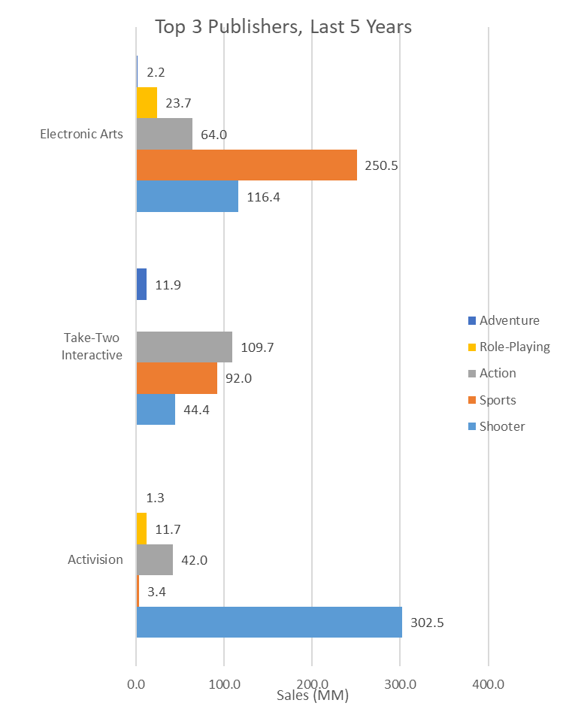
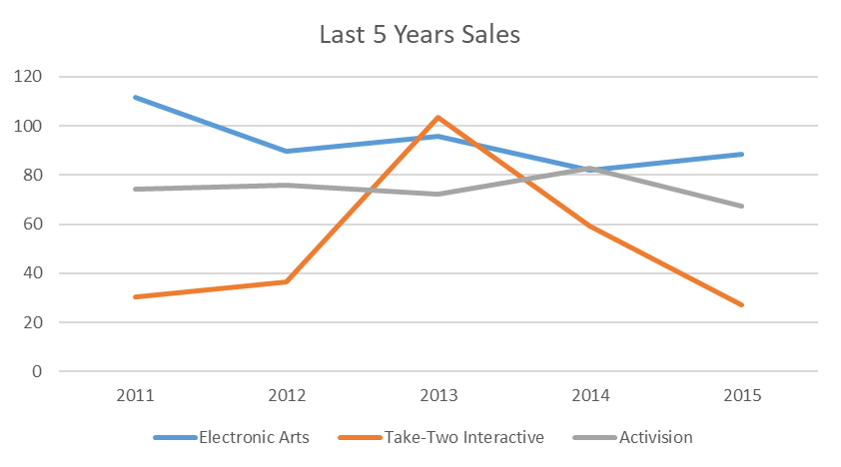
Competition Analysis
GameCo’s is poised to take on the competition
Electronic Art is most known for Sports games, not a recommended genre to pursue
Take-Two Interactive and Activision are both on the decline for any competing titles GameCo creates
*Sony & Microsoft Systems only, All Regions
*Sony & Microsoft Systems only, All Regions

Slide 7
Key Takeaways
The boxed video game industry is on a decline over the past 10 years. In order to maintain and increase market share against the competition, GameCo. should take initiative of the following:
Shift marketing resources from NA to EU
Develop games on current/new generation of platforms, ie. PS4/XOne
Focus efforts on critical genres, ie. Action, Shooter, Role-Playing

